Slide 1
Cyclic Voltammetry
Dr. A. N. Paul Angelo
Associate Professor,
Department of Chemistry
St. Joseph’s College,
Trichy - 620 002

Slide 2
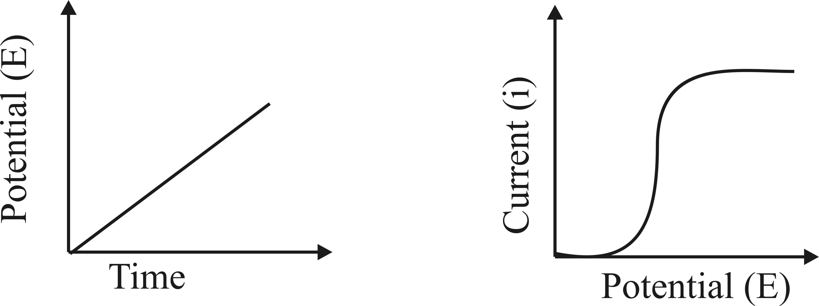
Voltammetry refers to the measurement of current (A) that results from the application of potential (V) to an electro active species.
Cyclic voltammetry is an electro analytical technique for investigating the electrochemical behavior of a system. It involves linearly sweeping the potential (increasing or decreasing) in the forward and reverse direction in a cyclic manner and recording the current response.
It was first reported in 1938 and described theoretically by Randles.
Apply Linear Potential with Time
Observe Current Changes with
Applied Potential

Slide 3
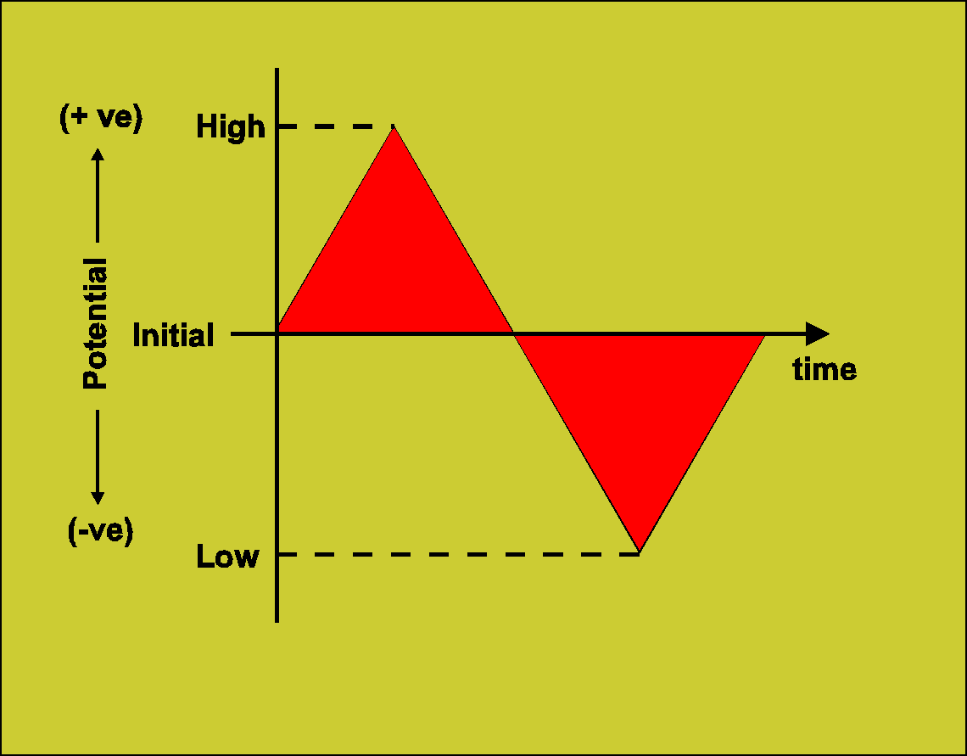
Involves linear scanning of potential of a stationary
electrode using a triangular waveform
- Solution is unstirred
- The most widely used technique for quantitative analysis of redox reactions
Provides information on
the thermodynamics of redox processes
the kinetics of heterogeneous electron transfer reactions
- the mechanism of coupled reactions

Slide 4
Three transport mechanisms:
(i) migration – movement of ions through solution by electrostatic attraction to charged electrode
(ii) convection mechanical motion of the solution as a result of stirring or flow
(iii) diffusion – motion of a species caused by a concentration gradient
The movement of the analyte to the electrode surface should be diffusion controlled, hence migration and convection current should be avoided.
Methods to eliminate migration and convection current
The use of supporting electrolyte, which carries the maximum current but does not undergo redox reaction at the operating potential eliminates migration current
50 to 100 folds excess of supporting electrolyte is added along with the test solution.
Convection current is due to thermal and mechanical agitation, it can be avoided by placing the instrument over an insulated, shock proof support.

Slide 5
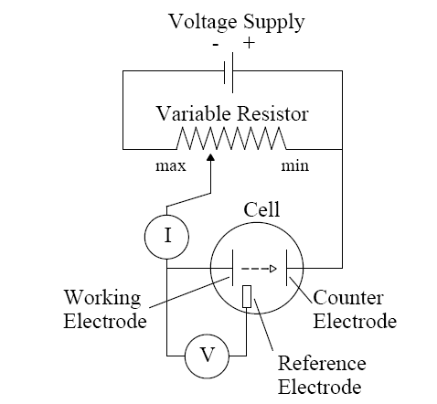
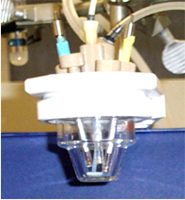
Instrumentation – Cyclic voltammetry involves three electrodes in solution containing analyte
Working electrode(WE): microelectrode whose potential is varied with time
Reference electrode(RE): potential remains constant (Ag/AgCl electrode or calomel)
Counter electrode: Glassy carbon or Pt that completes circuit, conducts e⁻ from signal source through solution to the working electrode
Supporting electrolyte: excess of non-reactive electrolyte (alkali metal) to conduct current

Slide 6
The terms involved in Cyclic voltammetry
Switching Potentials / Limiting potentials : Working electrode is swept between two potential limits E1 & E2 called the Limiting potentials or Sweeping potentials.
Triangular Wave form : The excitation signal is a pulse of potential between the limiting potentials that is exposed to the working electrode.
Cathodic Peak potential (Epc) : The peak potential of the cathodic process
Cathodic Peak Current (ipc) : The maximum current corresponding to the cathodic process.
Anodic Peak potential (Epa) : The peak potential of the anodic process
Anodic Peak Current (ipa) : The maximum current corresponding to the anodic process.
Scan rate (ν) : It is the ratio of potential expressed in millivolts (mV) to the time taken for the one complete cycle expressed in seconds (s) .
Ex: 500 mV/s.

Slide 7
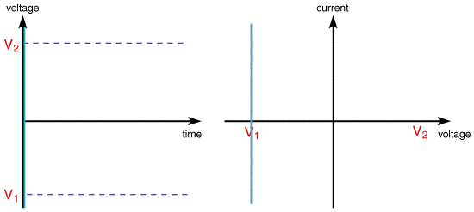

Slide 8
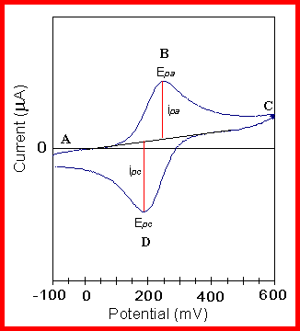
Typical cyclic voltammogram

Slide 9
Diagnostic tests for cyclic voltammograms of Reversible system at 25 °C
i_{p} is proportional to C
i_{p} is proportional to ν^{1/2}
- Implies electrode reaction is controlled by mass transport
i_{p}/i_{c} ≈ 1 for simple reversible couple
For a redox couple
Diagnostic tests for cyclic voltammograms of quasi-reversible system at 25 °C
i. ip increases with scan rate, but is not proportional to scan rate.
ii. ipc/ipa = 1, provided ac=aa = 0.5
iii. ΔEp is greater than 59/n mV and its increases with increasing scan rate
iv. Epc shifts negatively with increasing ν

Slide 10
Conclusion:
At the research level cyclic voltammetry is an handy tool to underestand the redox reaction of organic and inorganic species. It can reveal the exact oxidation state of the metal ions in the complexes. The ease at which the metal ion can be oxidized or reduced.
It can be utilized in the qualitative identification and quantitative estimation of a organic species.
It reveal the nature of the functional groups present in the organic moiety.
It can be used to find the types of electron transfer mechanism is follows like CE, EC, or ECE

